Slide 1
Hello everyone today we are going to talk about the risk of cancer
Cancer is a group of diseases involving abnormal cell growth with the potential to invade or spread to the other parts of the body
Introduction
Names: Raisa Cespedes-Florentino, Saydia Hossan, Alexandra Lim, Jaiden Mcquirter

Slide 2
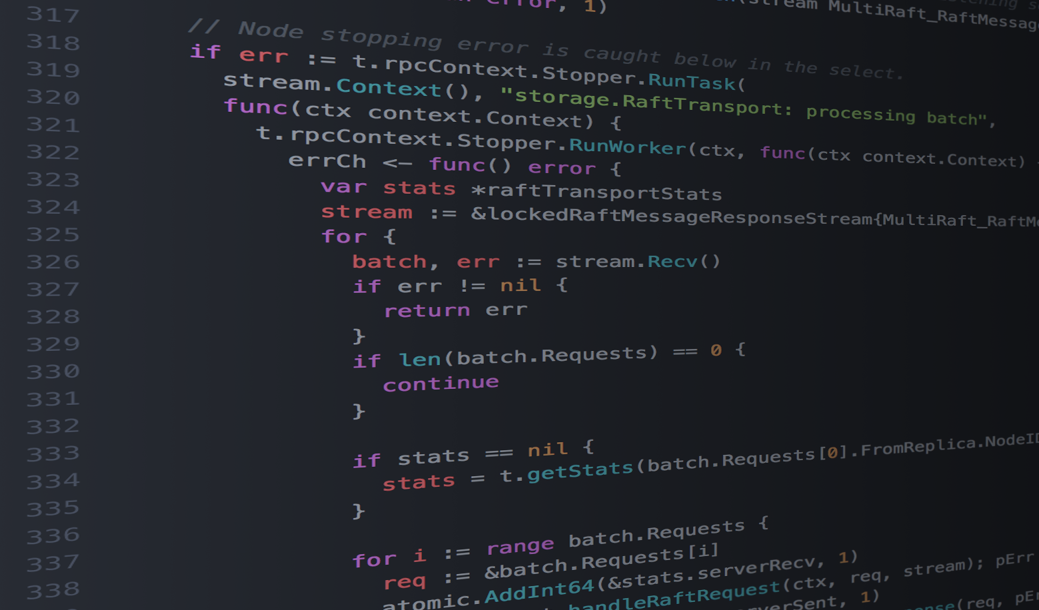
Code
import pandas
dir(pandas)
import plotly
from plotly.offline import plot
import plotly.graph_objs as go
cancercases = go.Bar(x=wodf["CancerType"], y=wodf["Number"],
marker = {"color": wodf["Number"],
"colorscale" : "Jet"})
plot([cancercases])

Slide 3
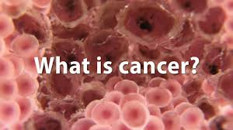
Introduction to Cancer
Cancer is when abnormal cells divide uncontrollably and destroy the tissues in the body.
Scientists are still in progress of finding a cure.
Cancer rates had fallen from 27% since 1991 to 1 2016.
1 in 285 will be diagnosed before the age of 20.

Slide 4
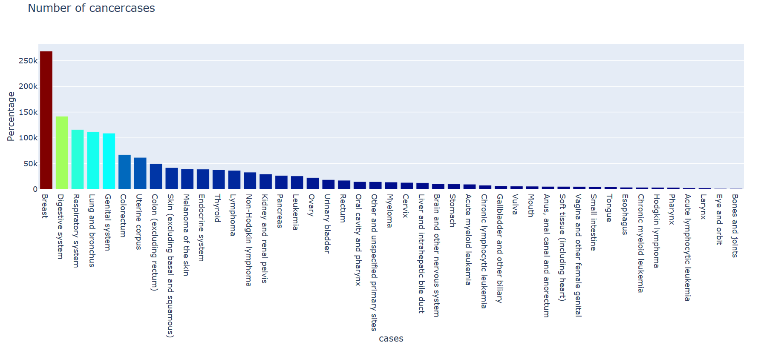

Slide 5
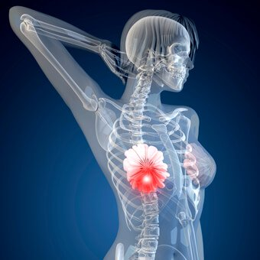
Breast Cancer
Obesity
Menstrual history
Heavy drinking
Previous medical treatments
Breast density
A sedentary lifestyle
https://www.cancercenter.com/cancer-types/breast-cancer/about?invsrc=non_branded_paid_search_google&t_pur=prospecting&t_med=online&t_ch=paid_search&t_adg=63728981674&t_ctv=305604118015&t_mtp=e&t_pos=1t3&t_plc=kwd-296873992251&t_si=google&t_tac=none&t_con=non_brand&t_bud=corp&t_d=c&t_tar=non_targeted&t_aud=any&kxconfid=s8ymtai82&dskid=%7btrackerid%7d&t_mod=cpc&t_cam=1604504770&t_trm=what%20cause%20breast%20cancer&t_src=g&dstrackerid=43700046124201519&gclid=CjwKCAjwqNnqBRATEiwAkHm2BAPjOsGCEhg5_Zx-Q9SARARart-zd5WqlDIy6BRO7rVNknKUmVOl6RoC7fEQAvD_BwE&gclsrc=aw.ds

Slide 6
Conclusion
Increasing the awareness in cancer is crucial for the development of new research to stop cancer
Funding research
Funding efforts like- Breast Cancer Awareness
Spread awareness about all the different cancers
We believe if the numbers in the STEM program were to increase there would be more scientist, technologist and engineers helping with the cure of all cancers.

